Slide 1
Update on Power Plan Needs Assessment: Revised Baseline ARMs and Capacity Contribution Studies
System Analysis Advisory Committee
3/17/2021
John Ollis

Slide 2
Baseline Needs Assessment Summary
Region has significant needs in the action plan time frame with the most needs in the winter.
The market has low priced power in every season in the middle of the day and NW hydro system is effective at utilizing it to meet needs.
Conservation continues to work in tandem with the hydro system well to address adequacy issues, however many other resources do as well
Summer peak needs seem to be more challenging to meet than winter peak needs with the current market economics.

Slide 3
Agenda
Review the Role of the Needs Assessment in Picking a Resource Strategy
Determine Regional Needs
Assumptions for 2023, 2027 and 2031
Adequacy Reserve Margin results
Determine How Different Resources Meet Those Needs
Assumptions for 2031 studies
Associated System Capacity Contribution results

Slide 4
Needs Assessment Role in Power Plan
How do these simulations guide our result in the plan?

Slide 5
Get A Strategy
AURORA Buildout
Long term capital expansion for the WECC ensures that price simulations in AURORA are informed by an adequate system that meets policies
AURORA Price Runs
Hourly WECC-wide price simulations inform market prices and associated emissions in the RPM, both can significantly impact regional resource strategy economics
Hourly market capability is needed for GENESYS to provide a good adequacy signal for the NW informed by changing market fundamentals
GENESYS
RPM
Hourly analysis in GENESYS creates quarterly ARMs and ASCCs, which the RPM uses to select an adequate resource strategy

Slide 6
Check A Strategy
AURORA Buildout
Long term capital expansion for the WECC ensures that a check in AURORA is informed by an adequate system that meets policies
AURORA Check
Candidate regional resource strategy may be checked within the context of the WECC to ensure we are consistent with policies and operational feasibility within a WECC-wide context.
GENESYS Check
RPM
Candidate regional resource strategy is checked in GENESYS to ensure the system is adequate and operationally feasible.

Slide 7
What Changes Between Scenarios?
Adequacy Reserve Margins
Will likely change in many of the scenarios where the following is true:
Market price, composition, structure or reliance levels change significantly
Existing resources are retired on a different schedule than baseline
Existing and new resources dispatch based on a emissions price
Associated System Capacity Contribution Array
Will likely not change in most scenarios.
Is designed to work with multiple scenarios.

Slide 8
Assumptions and Methodology Review
Existing resources, market availability and size, reserves

Slide 9
Review: Existing Resources
For the Baseline Needs Assessment for the plan:
Inside the region: No additional generating resources or EE, coal retirements as currently announced.
Jim Bridger 1 out after 2023
Centralia 2 and North Valmy 2 out after 2025
Jim Bridger 2 out after 2028
Outside the region: The long term AURORA buildout
Represented as extra-regional load forecasts as in AURORA and market supply price bins reflecting retirements and additions per the AURORA forecast
Transmission limitations: Similar to AURORA

Slide 10
Review: Regional Portfolio Capability is Decreasing and Loads are Growing

Slide 11
Review: Market Reliance Assumptions in the Classic and Redeveloped GENESYS
Resource | Redeveloped GENESYS Assumptions | Classic GENESYS Proposed Assumptions
Winter SW spot market | 2,500 MW total all hours | 2,500 MW all hours
Winter SW purchase ahead market | 2,500 MW total all hours* | 3,000 MW off peak hours
Winter IPP availability | Full (2,403 MW) | Full (2,403 MW)
Summer SW spot market | 1,250 MW total all hours | 1,250 MW 9am to 2pm
Summer SW purchase ahead | 1,250 MW total all hours | No purchase ahead market
Summer IPP availability | Full (2,403 MW) all hours | Full (2,403 MW) 8am to 6pm
MT and WY wind | 1,461 MW included | 1,461 MW included
* See next slide (depends on market fundamentals)

Slide 12
Review: Incorporating Market Supplies
Classic GENESYS – User provided fixed inputs
SW Spot Market – 2500 MW winter, 1250 MW summer (limited to 5 hours/day)
SW Purchase ahead – 3000 MW winter limited to off-peak hours, none in summer
Max 3400 MW total import (spot + purchase ahead)
SW market priced higher than any NW resource
NW IPP market resources – fully available (limited to 10 hours/day in summer)
New GENESYS – Dynamic assessment of supply, user provided limitations
Simulates dispatch of out-of-region resources & loads
User can limit imports into the PNW by season (after accounting for regional resources that are physically outside our region)
No option to control hour-of-day market availability
NW IPP market resources available to all markets (not just the PNW)
Market exchanges (for all regions) based on price dynamics

Slide 13
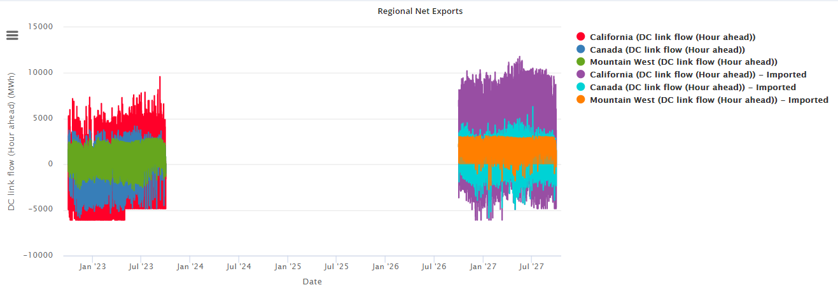
Market reliance limit plus room for firm external resources (like Bridger and Valmy) to import to the region .
Note the considerable amount more net exports total and decrease in net imports.
Comparison between 2023 and 2027 net market position by net export region.

Slide 14
2023
Out of region supply creates dramatic day/night import export dynamic.
2027

Slide 15
2027 Winter
In summer, BC has more supply available to export in the evening…
2027 Summer

Slide 16
Even though net market reliance is limited the large external buildout still effects market supply fundamentals

Slide 17
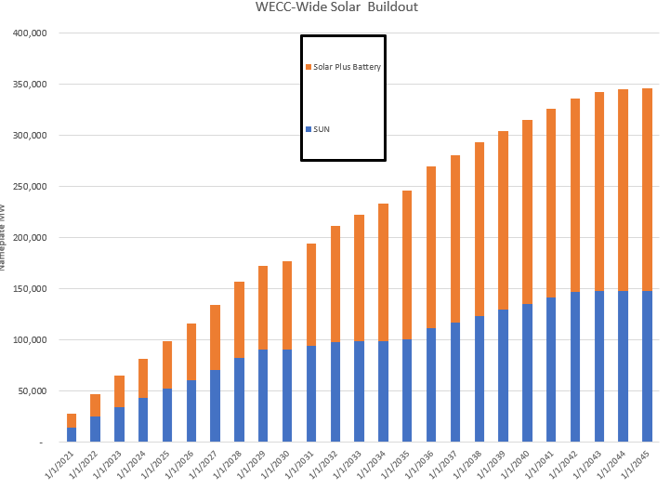
Daily shape changes with more WECC- wide solar

Slide 18
Review: Balancing Reserve Assumptions
Per Northwest Power Pool EIM Study (public data)
Each BA has to hold and provide balancing reserves specified in the study on existing (or new) resources
Consistent with assumptions for AURORA
Fidelity on a monthly basis for hour of day
No balancing reserve sharing between BAs
Very conservative considering all entities would be in EIM and holding all the reserves from the NWPP EIM study should ensure sufficiency
Since the model does not currently reserve transmission for reserves there was some congestion/reserve provision adequacy issues for utilities with remote resources (SCL, PGE, PSE, PAC) that would not happen in operations (per modern transmission scheduling practices).

Slide 19
Example: On Sept 2nd, at 8 am, there is a small deficit in Seattle. The region is long in aggregate and could have covered the deficit with contingency reserves but this is still considered an adequacy event for planning purposes. Why?

Slide 20
While theoretically this could still be an issue, in the model this is happening because firm transmission is not scheduled for reserve provision. In practice, the transmission likely would have been scheduled…

Slide 21
Fuel Accounting for All Resources
Reserve Provision
All resources must have fuel available to provide reserves
Energy limited resources (Hydro, demand response, batteries and pumped storage)
Variable availability fuel resources (Wind, solar and hydro)
On call fuel resources with limits (most gas resources)
On call fuel resources with no limits (some gas and coal resources)
Future value of stored fuel
Hydro (also pumped storage and batteries to an extent)
Conservative assumption on gas fueling flexibility
Draft and pack limits at 3% with exception of plants with access to storage (eastside gas likely has more flexibility)
One nomination assumed per day (5 nomination windows)

Slide 22
SAAC and Stakeholder Feedback
Concern about market effects on adequacy
Market reliance limits are effectively mitigating much of these concerns and are definitely responsible for more adequacy events in the simulations
Testing of different market conditions is a planned part of scenario work especially the scenario focused on market reliance and organized markets
Some forecast error based events are reasonable, should there be so many?
Staff implemented two changes since that time that significantly reduced the forecast error related outages
Allow balancing reserve sharing (as is current practice in the EIM) to address transmission reserve issue
Allow eastside gas plants to vary more significantly off gas nomination schedule

Slide 23
Changes in Methodology per Staff Observations and SAAC Feedback
Increase fuel flexibility of eastside gas units (existing and new)
Change from ± 3% to ± 50% the daily nomination schedule for all units with access to eastside gas
Work around transmission reservation issue for reserves held on remote resources to reduce forecast error related deficits
Let regional reserves to be the sum of the maximum balancing reserves held by each BA (maintain sufficiency)
Allow reserves to be shared within the region in the true up stage (allow for sharing of reserves
Reduce negative capacity contributions
Start with a less adequate system (maybe a different base year, maybe more retirements…)
Fix issue related to units with gas limitations inability to provide reserves.
Increased load to similar magnitude highest load future in RPM
Retired all coal in region by 2031

Slide 24
Adequacy Reserve Margin Results
Defining the need…

Slide 25
Review: Calculation of Adequacy Reserve Margins
${ARM}_{C}=\frac{(Existing Resource Peak Capability+X_{C}– Peak Load)}{Peak Load}$
$X_{C}$ is the maximum amount of hourly need in a quarter that, if met, would eliminate all peak shortages in 95% of the simulations
${ARM}_{E}=\frac{(Existing Resource Average Energy+X_{E}–Average Load)}{Average Load}$
$X_{E}$ is the amount energy in a quarter that would eliminate all energy shortages in 95% of the simulations
Note that these calculations allow the 5% adequacy criteria to be translated into something like a “planning reserve margin.”

Slide 26
Effects of New Features on LOLP: Redeveloped GENESYS versus Classic GENESYS
Out-of-region market supply Decrease if supply is limited to classic GENESYS assumptions (due to dynamic vs. prescribed hourly availability)
Plant specific hourly hydro simulation: Increase New model has more hourly operating constraints, but classic model sustained peaking may be conservative
Multiple NW nodes: Increase Classic GENESYS only models 2 NW nodes
Unit commitment: Increase Classic GENESYS has very limited unit commitment logic
Dynamic balancing reserves: Increase Classic GENESYS only includes a fixed allocation of hydro reserves and no thermal reserves
Forecast error: Increase Classic GENESYS does not model forecasting error
Optimization: Decrease All else being equal, this should lower LOLP in order to reduce curtailment costs
2023 LOLP | 2025 LOLP | 2027 LOLP | 2031 LOLP
32% | 27% | 1% | 3%
Classic GENESYS result
Forecast error and unit commitment are still associated with deficit issues in around 40% of the games in 2023 but far fewer events within the games.

Slide 27
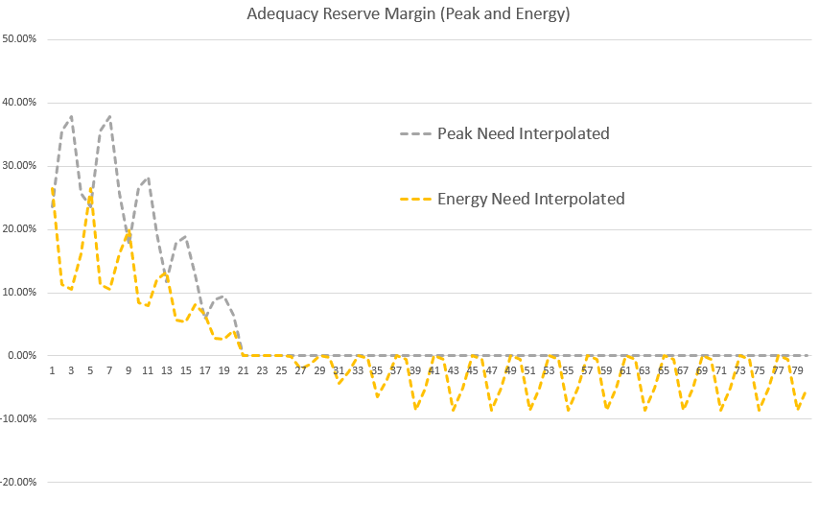
Summary of Adequacy Reserve Margin Results
Observation:
System is becoming more adequate without adding resources!
Why?
Many low variable cost renewables built in WECC to meet policies and replace retired resources.
Even with limited market reliance, NW hydro is well positioned to utilize available surplus to relieve adequacy issues
Required reserve margin to meet a 5% LOLP standard decreases over time on a peak and energy basis.

Slide 28
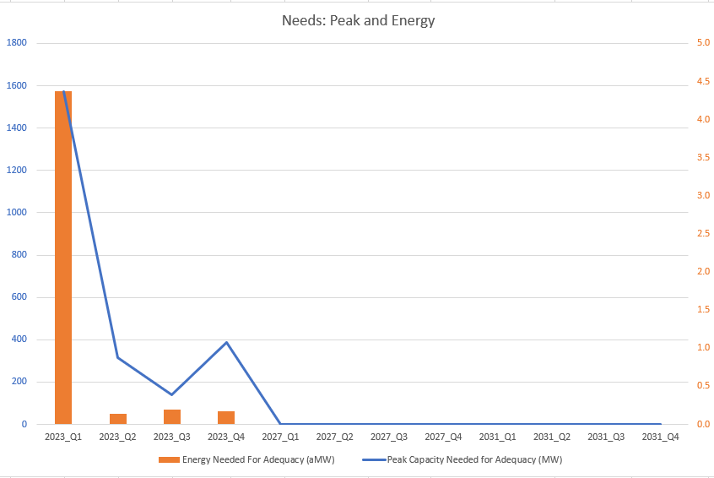
Large peak adequacy issues in 2023 (primarily winter)
Increasing lower priced WECC market supply by end of action plan time period leads to less adequacy issues.

Slide 29
ARM Results Summary
High Level Purpose
The RPM uses the ARM results to translate the Council’s adequacy requirement of 5% into peak capacity and energy needs the regional portfolio must meet to be adequate.
Observations
Significant adequacy issues due to forecast error, unit commitment issues and more detailed operational considerations.
Adequacy issues decrease over time due to increase in inexpensive external market supply even though net market reliance limit is held constant.

Slide 30
Capacity Contribution Results
After a bunch of caveats… the amount of peak needs met by changing the regional portfolio

Slide 31
Associated System Capacity Contribution (ASCC) Purpose
Is not a “capacity factor”
Is not a “effective load carrying capability”
Is the capacity contribution associated with adding a particular portfolio of new resources in context of the existing system.
Like the ARM is just a way to turn the 5% LOLP adequacy criteria into a quarterly need
The ASCC is just a way to get a portfolio of resources expected capacity contribution in terms of how many of those quarterly needs it can address specific to how the RPM considers peak adequacy.
The ASCC is specific to the regional footprint and portfolio
These numbers only mean something in context of the RPM

Slide 32
Pup Quiz!
Should I use the Council’s ASCC numbers as a proxy for capacity factor or ELCC for my own portfolio?
NO!
This Photo by Unknown Author is licensed under CC BY-ND
Associated System Capacity Contribution is designed specifically for use in the RPM tuned to the regional or BPA footprint
This Photo by Unknown Author is licensed under CC BY

Slide 33
Associated System Capacity Contribution – A Project Management Tool
Without lots of iterative hourly studies we can take complicated operational aspects of a set of resources or resource types and convert those into a simple peak capacity contribution indexed by the amount of resource added.
Even so, it took over 100 hours of staff/contractor time and significant cloud computing budget just to execute and process the results from 11,610 simulations.
Allows RPM to be focused on testing policy scenarios over many futures and not take weeks to complete one run.
A few notes:
It would be calculated differently if we did not use LOLP as our adequacy metric
It is calculated differently per the assumptions in the model used to estimate it.
Market economics and reliance key assumptions, but market reliance limits significantly limit effect of market economics.
This Photo by Unknown Author is licensed under CC BY-SA

Slide 34
Assumptions
This run is designed to be representative of the capacity contribution and work with as many scenarios as possible.
Similar to 2031 ARM simulation (with two exceptions)
All regional coal units retired
Regional load increased by 8%, which is similar in magnitude to the highest 2031 load future in the RPM
Examine 30 different hydro conditions and temperature years with 3 different associated wind conditions.
Recall both the ARM and ASCC are really just metrics we use to pass information to the RPM to ensure that when we check a resource strategy that it meets the Council adequacy standard of 5% LOLP.

Slide 35
Resource Types and Amounts Tested in the ASCC Array
Staff ran all 128 combinations of these resource type amounts. Each combination has 4 quarterly ASCC values.
0 MW and 2750 MW Thermal
modeled as 2 CCCT and 4 SCCT on the east side of the region (also modeling proxy for existing coal)
0 MW and 3000 MW Short Duration Energy Limited Resources
modeled as 300 MW, 4 hour batteries in 10 different BAs
0 MW and 2000 MW Long Duration Energy Limited Resources
modeled as three 8 hour pumped storage plants (one 1200 MW and two 400 MW)
300 aMW and 3500 aMW EE
modeled as a proportional reduction in load in every BA in the region with hourly shapes appropriate to the first few and almost all the bins of EE, respectively
0 MW and 5000 MW Solar
modeled as five 1000 MW east side solar plants
0 MW and 6000 MW Montana and SE WA Wind
modeled as a one ASCC resource type and two 1500 MW plants.
0 MW and 1900 MW Gorge Wind

Slide 36
Use of the ASCC Array in the RPM
The 128 different discrete combinations of resource portfolios are entered into the RPM.
A multilinear interpolation is used to allow the RPM approximate the capacity contribution of any new resource build in the RPM.
Thus, no matter what resource strategy is in the RPM, the RPM uses the ASCC array to see how much it reduces peak needs.

Slide 37
Modified ASCC Methodology – Using two sets of GENESYS simulations
Base run maximum deficits by game g and quarter q
$${Max({Deficits}^{Base})}_{g,q}$$
Run with capacity added maximum deficits by game g and quarter q
$${Max({Deficits}^{ResourceAdd})}_{g,q}$$
Calculate difference by game g and quarter q
$${{∆_{g,q}=Max({Deficits}^{Base})}_{g,q}−Max({Deficits}^{ResourceAdd})}_{g,q}$$
Take the expected value of those differences over all the games and divide by size of resource, R, gets selected in RPM*
$${{E(∆}_{g,q}) }/R$$
* Nameplate MWs for all but EE which is selected by aMW
Peak needs before adding resources
Peak needs after adding resources
Peak needs reduction by adding resources
Expected peak needs contribution by adding resources

Slide 38
Examples of Capacity Contribution Results
This implies 300 aMW of EE reduces 965 MW of winter need.
Quarter | 300 aMW EE | Peak needs reduction after adding 300 aMW |  | 300 aMW EE and 5000 MW of solar | Peak needs reduction after adding 300 aMW and 5000 MW of solar
1 | 3.21 | 965 MW |  | 1.14 | 6016 MW
2 | 0 | 0 MW |  | 0.02 | 125 MW
3 | 0.17 | 51 MW |  | 0.06 | 332 MW
4 | 0.10 | 29 MW |  | 0.16 | 844 MW

Slide 39
Different Resource Combinations Reduce Needs More Efficiently
Resource Combination | Total Resource Add | Q1 Peak Needs Met | Q2 Peak Needs Met | Q3 Peak Needs Met | Q4 Peak Needs Met
300 aMW EE | 300 | 965 | 0 | 51 | 29
300 aMW EE and 5000 MW Solar | 5300 | 6016 | 125 | 332 | 844
300 aMW EE and 3000 MW Montana and SE WA Wind | 3300 | 3337 | 0 | 209 | 1570
300 aMW EE and 1900 MW Gorge Wind | 3300 | 8361 | 0 | 254 | 1276
300 aMW EE and 2000 MW Long Duration Energy Limited | 2300 | 8361 | 125 | 228 | 1251
300 aMW EE and 3000 MW Short Duration Energy Limited | 3300 | 8361 | 125 | 367 | 1963
300 aMW EE and 2550 MW Thermal | 2850 | 8361 | 125 | 287 | 1263

Slide 40
In most days of all seasons and scenarios, NW and BC import excess power from the SW during the day and export during the night, but when there are adequacy issues the dynamics can look different

Slide 41
ASCC Base
When there is an adequacy event, the hydro system may have the capacity but not the fuel to meet regional needs. In this case, almost an 9000 MW deficit is negated by adding 300 aMW and 5000 nameplate solar.
Region added 300 aMW of EE and 5000 Solar

Slide 42
ASCC Results Summary
High-Level Purpose:
Use ASCC array to pass information on how different resource combinations can be expected to reduce peak needs as established by the ARM.
Observations:
Staff is still analyzing the results, but so far…
EE is very effective at eliminating needs.
Winter Needs: (Traditional capacity and energy issues) All resources are effective at addressing.
Spring Needs: (Flexibility issues) Tend to be more difficult to eliminate, but energy limited resources and thermals tend to be most effective.
Summer Needs: (Many forecast error and ramping issues) Tend to be more difficult to eliminate, but energy limited resources, EE and Gorge wind seem most effective.
Fall Needs: (Less hydro to absorb solar) All non-solar resources address fairly effectively.

Slide 43
Next Steps: Ensuring a Resource Strategy is Adequate
Classic GENESYS Needs Assessment Data (ARM, ASCC and hydro generation) for testing
Studies in Redeveloped GENESYS to derive Adequacy Reserve Margins (ARM) and hydro Generation
Studies in Redeveloped GENESYS to derive Associated System Capacity Contribution (ASCC)
Check Resource Strategy
Repeat ARM calculations and checks for scenarios

Slide 44
Questions
jollis@nwcouncil.org – John Ollis

Slide 45
Thermal Generation looks similar in magnitude but different in usage
More cheap solar available midday, even in summer shifts thermal use for capacity and adequacy purposes

Slide 46
Hydro Generation similar in magnitude but shaping becomes more extreme

