Slide 1
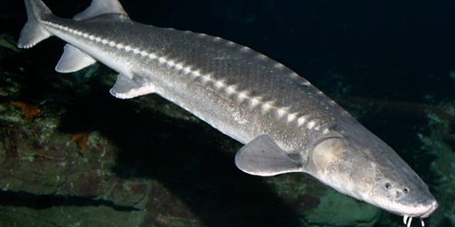
PIT Tagging and
White Sturgeon Assessments
Presentation to the Fish Tagging Forum
of the Northwest Power and Conservation Council
March 22, 2012

Slide 2
Topics
Overview of Sturgeon Management Areas and Projects
Broad Management Questions
Examples of how PIT tags are improving assessments
Down sides of PIT tags for sturgeon?

Slide 3
Sturgeon
Management
Planning
Units

Slide 4
Tagged Fish by year and area
 | Sub-Population / Reach
Year | Below Bonneville | Bonneville | The Dalles | John Day | McNary
1993 |  |  | 127
1994 |  | 1,147 | 3,739
1995 |  |  | 5,601 |  | 467
1996 |  |  | 2,169 | 4,089
1997 |  |  | 3,799
1998 |  | 2,641
1999 |  |  | 3,491
2000
2001 |  |  |  | 3,709
2002 |  |  | 2,712
2003 |  | 6,312
2004 |  |  |  | 4,704
2005 |  |  | 5,293
2006 |  | 6,909
2007 |  |  |  | 4,528
2008 |  |  | 6,378
2009 | 2,853 | 7,639
2010 | 4,626 |  |  | 4,039
2011 | 3,317 |  | 5,175 |  | 273
Sum | 10,796 | 24,648 | 38,484 | 21,069 | 740

Slide 5
B. Broad Management Questions
Are populations at risk of extinction?
Are there productivity losses and lost harvest potential due to anthropogenic threats?
How have various limiting factors and threats affected vital rates?
How effective are management actions at reducing threats?
What are appropriate sustainable harvest rates in our current environment?

Slide 6
Population Attributes needed to address Management Questions
Eggs
Age-1
Carrying Capacity
Juvenile
Natural Mortality &
Unexplained Loss Rates
Growth Function
Spawning & Rearing
Conditions
Sub-adult
Predation Mortality Rates
Fishing Mortality Rates
Adult
Reproduction

Slide 7
C. Examples of how PIT tags are improving assessments
Improved Abundance Estimates
MLE survival estimates
Assessing growth rate relative to traditional methods
Assessing transplant supplementation success
Assessing hatchery effectiveness
Assessing movements among reservoirs
Assessing exploitation rate relative to harvest number

Slide 8
Improved Abundance Estimates
Short-lived external tags and marks
  Limited time-period for recaptures
  Petersen-like mark-recapture estimates
  N=M*C/R
Persistent PIT tag
  Long time series mark-recapture estimates
  Maximum Likelihood Estimator models
  Live Dead encounter histories LDLDLDLDLD
  Ever growing data set and improved precision over time

Slide 9
Lower Columbia River White Sturgeon
42” – 60” White Sturgeon
Notes:
9

Slide 10
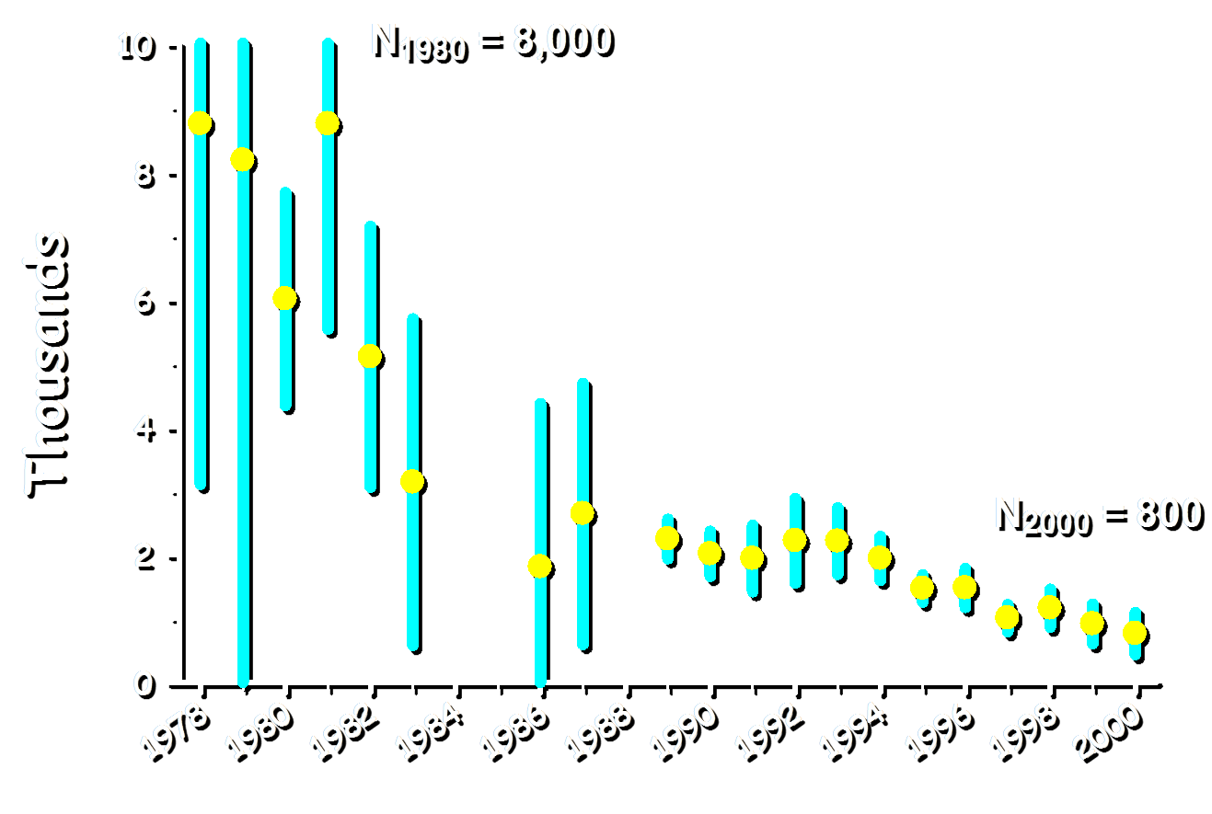
Kootenai Adult Sturgeon Abundance

Slide 11
Kootenai Recapture Rates

Slide 12
Survival Assessments
Catch rate based assessment of diminishing abundance through time
  Catch curves and cohort analyses
Persistent PIT tag
  Long time series mark-recapture estimates
  Maximum Likelihood Estimator models
  Live Dead encounter histories LDLDLDLDLD
  Ever growing data set and improved precision over time

Slide 13
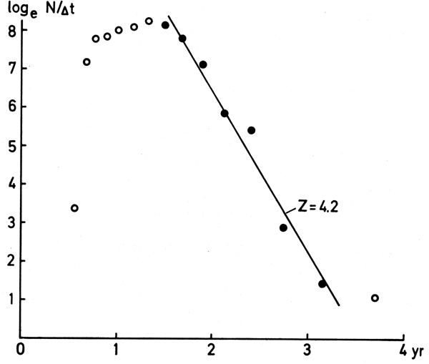
Catch Curve

Slide 14
Bonneville Juvenile White Sturgeon
MLE Annual Survival Rates

Slide 15

Growth Assessment

Slide 16
Growth Assessment

Slide 17
Growth Assessment

Slide 18
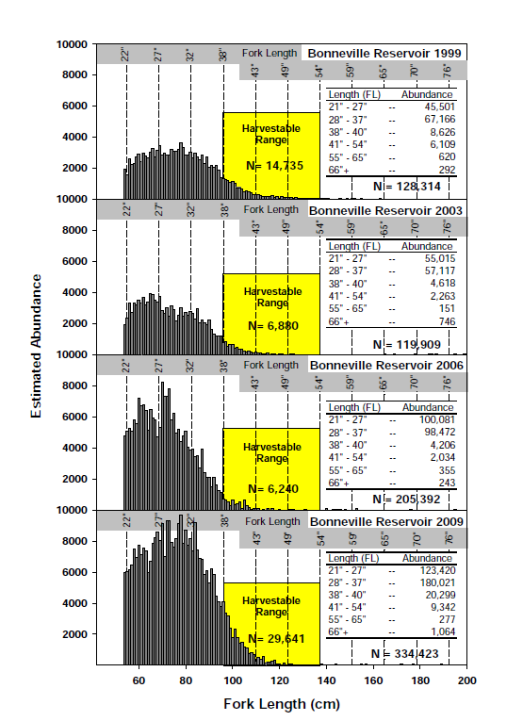
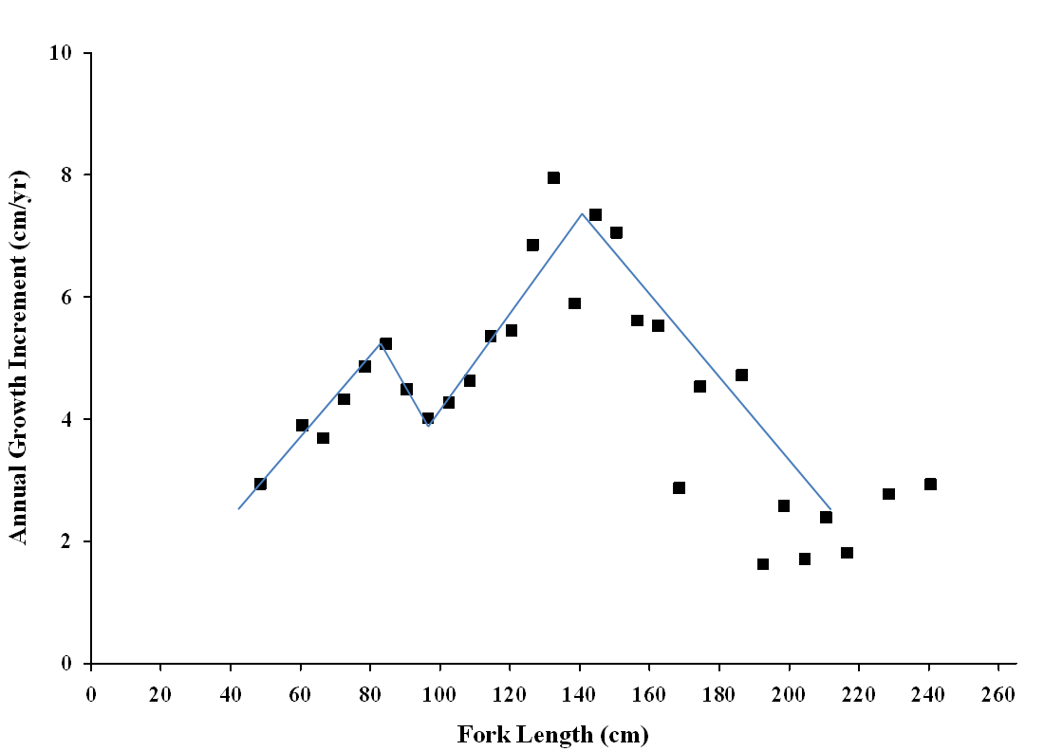
Growth
Assessment

Slide 19
Examples of how PIT tags are improving assessments
Improved Abundance Estimates
MLE survival estimates
Assessing growth rate relative to traditional methods
Assessing transplant supplementation
Assessing hatchery effectiveness
Assessing movements among reservoirs
Assessing exploitation rate relative to harvest number

Slide 20
D. Down sides of PIT tags for sturgeon?
Strengths | Shortcomings
Persistent individual mark readily identified by co-managers
Non-lethal detection
Centralized data storage
Tiny size
Extra gear for samplers to carry- Special tool to recognize tag
Limited remote detections
No data volunteered by anglers
Relatively expensive. Esp. w/o NPCC purchase agreements
Tag placement
Historic issues with vendors and coding

Slide 21
Notes:
Introductions

