Slide 1
Overview of the Impact of Research and Monitoring in the Columbia River Basin
Rob Clapp
Gary Rule
Blane Bellerud
Ritchie Graves

Slide 2
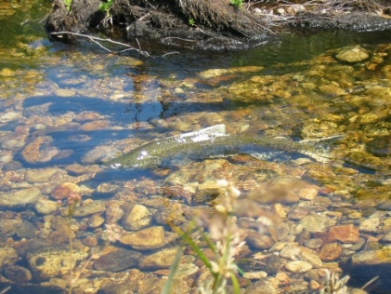
Outline
Research and Monitoring Permits
Effects of Research and Monitoring
Effects of Tagging
Goals and Expectations

Slide 3
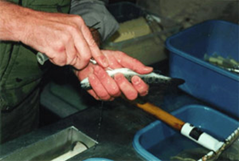
Research and Monitoring Permits for ESA Listed Salmon and Steelhead
NOAA Fisheries authorizes hundreds of research and monitoring projects each year.
We consult on both naturally produced and listed hatchery fish.
4(d) Limit 7 Authorizations
Letters of Authorization
Section 10 Scientific Research Permits

Slide 4
ESA Section 4 – Listing Determinations
Protective regulations for threatened salmon and steelhead – “4(d) Rules”
13 “Limits” on the take prohibitions
Limit 7 allows NMFS to exempt state scientific research programs from the take prohibitions (annual authorization)
Types of research and purposes vary
Many of the projects are linked to other actions
There were 165 projects in the 2011 research program (ID, OR, WA)
Two-thirds of those projects were in the Columbia Basin
58 of the Columbia Basin projects include tagging and/or marking

Slide 5
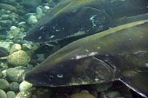
ESA Section 7 – Interagency Cooperation
FCRPS and Willamette Biological Opinions
Consultation with a Federal agency
Authorizes incidental take
The Incidental Take Statement includes research and monitoring
Annual Letters of Authorization from NMFS Hydro Division
Approximately 30 FCRPS and 10 Willamette Biop LOAs annually

Slide 6
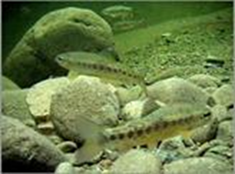
ESA Section 10 - Exceptions
Sec. 10(a)(1)(A)—direct take permits for scientific purposes
Anyone can apply
Endangered and threatened species
Types of research and purposes vary
Many of the projects are linked to other actions
About 108 permits in 2011, more than half of which were for projects in the Columbia Basin
25 of the Columbia Basin permits include tagging and/or marking

Slide 7
Authorized take of naturally produced fish for research and monitoring under Section 10, 4d, and FCRPS (2011)

Slide 9
Effects of the Authorized Research
Protected Resources Division authorizes/permits research under sections 4(d) and 10 of the ESA.
For years, the assigned mortality rates have ranged from 1% to 3%.
N.b., under the ESA and NEPA, research and monitoring are not considered to be the same: Research must “not operate to the disadvantage of the species,” AND not be individually or cumulatively significant. This is starting to raise some concerns.

Slide 10
Literature Review
A preliminary review of the published work suggests that our estimates of effect (with respect to mortality, at least) need a hard look.
A few points to highlight—the research is highly variable with respect to what’s being tested; there seems to be a direct correlation between tag size and mortality rates, there seems to be an inverse correlation between fish size and mortality rates.
An even more preliminary look at other tags, handling, electrofishing, etc. indicates that our estimates of effect from them may be similarly low.

Slide 11
Summary
Given these factors (amount of effort, increasing scrutiny, poorly understood effects), we need to minimize take and combine efforts. This may well have the added advantage of lowering costs.
We haven’t yet got a handle on take from hatchery, harvest, or habitat effects.
We have not factored in sublethal effects and, to some extent, delayed mortality
Several factors driving the increasing level of effort.
The increasing effort, coupled with the increasing scrutiny, points out the need for setting regional priorities and process.
Regional protocols will also be needed.

Slide 12
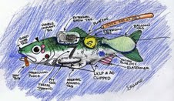
Questions?
Rob Clapp – robert.clapp@noaa.gov
Gary Rule – gary.rule@noaa.gov
Blane Bellerud – blane.bellerud@noaa.gov
Ritchie Graves – ritchie.graves@noaa.gov

